Slide 1

See At Yonder
Earthquake do not kill people, man in his role as a builder, kills

Slide 2
An Asset, one can seldom miss! With more than 150 years of life for the apartment, it sure is a legacy to be passed on to future generations. Believe it, a fact, a big phenomenon happening around you. A rare of the rarest opportunity, one lest think to miss.

Slide 3
Sesharatnam’s LANDMARK
Quintessential Earth Quake Design
IS:13920 & 1893
Feel the vibrant Life with perfect Ambience.

Slide 4
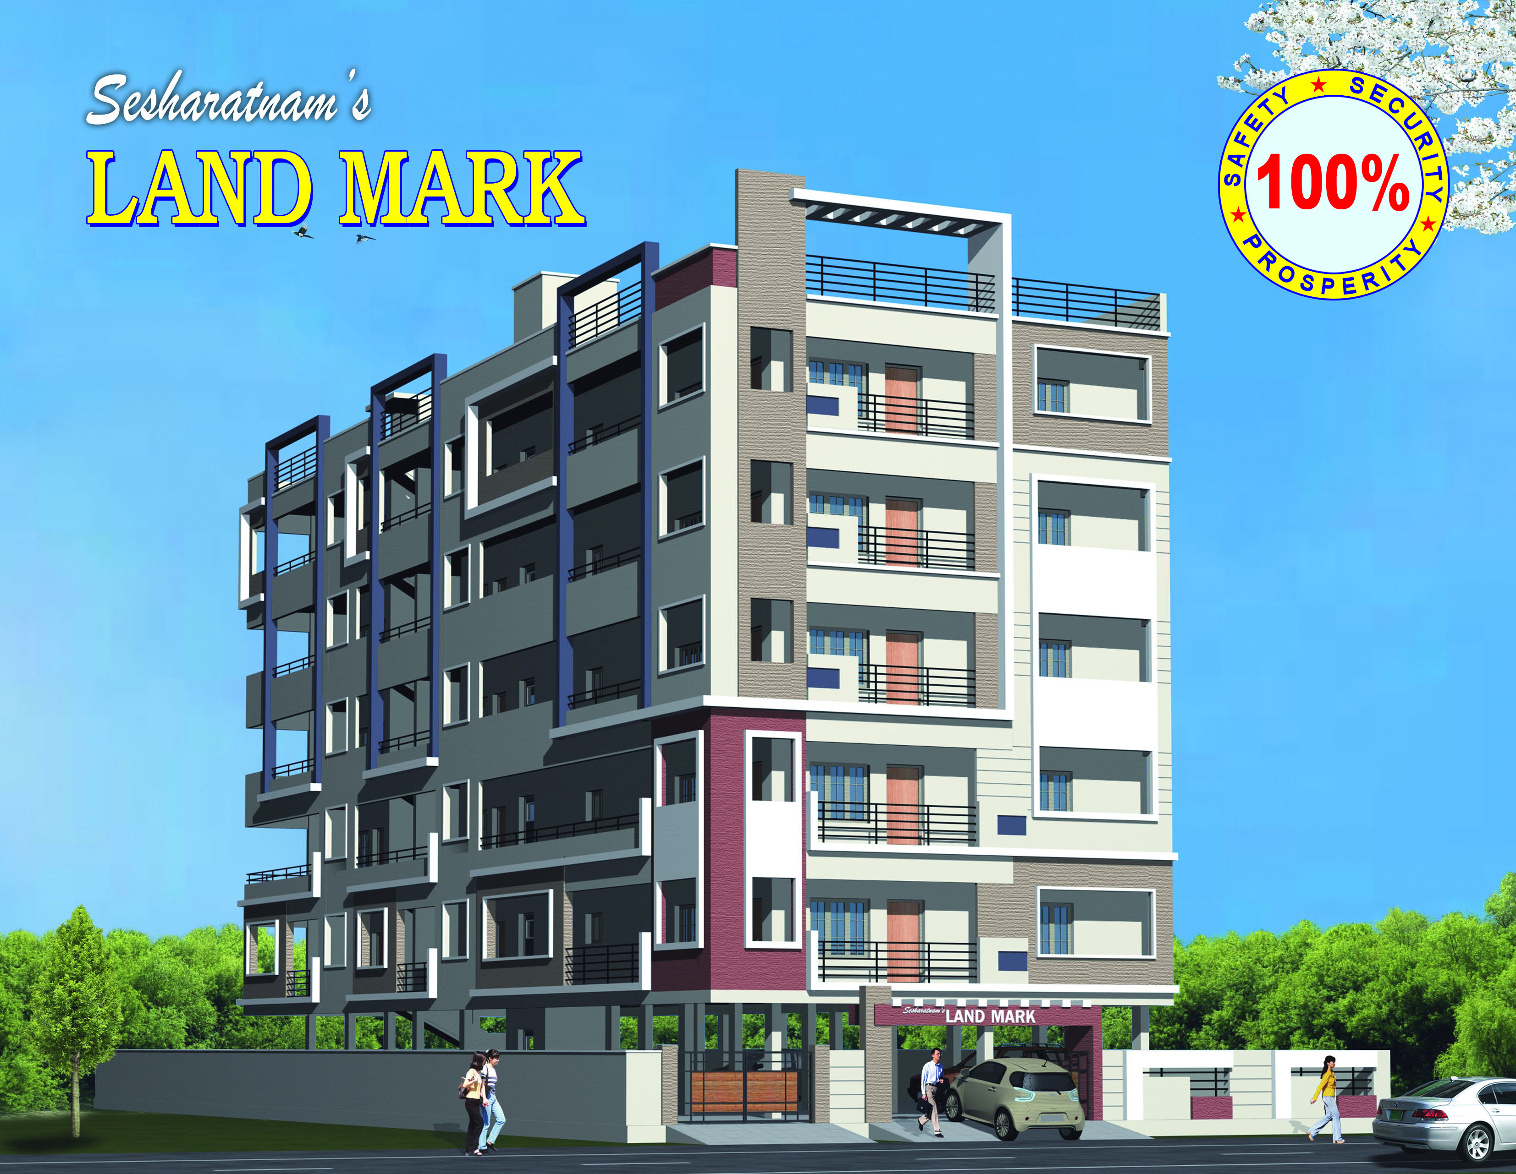
BEAUTY OF QUALITY

Slide 5

Casual Elegance is all about the mix
100% Safety,
Security,
Prosperity.
Striking the chord of equilibrium between luxury and comfort that makes you want to stay at home that extra bit.

Slide 6
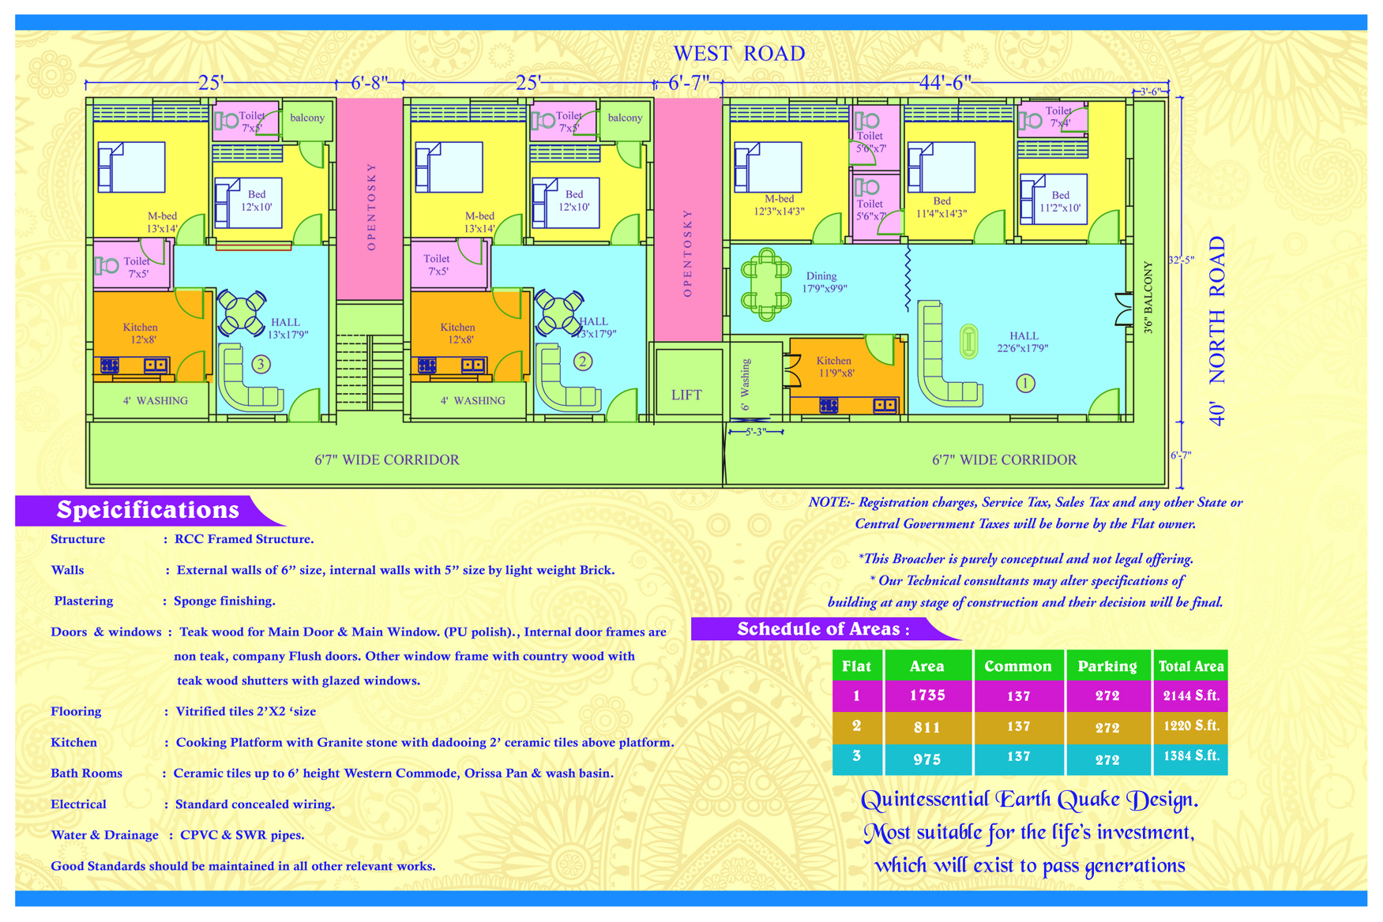

Slide 7
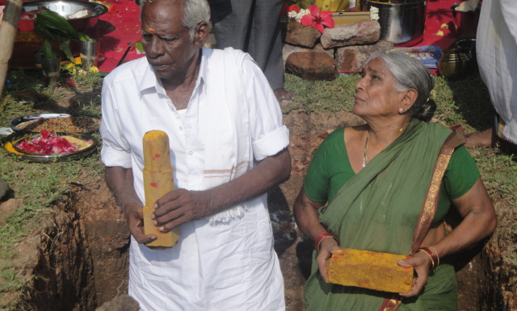
‘Sankusthapana’ ritual performed in traditional manner

Slide 8
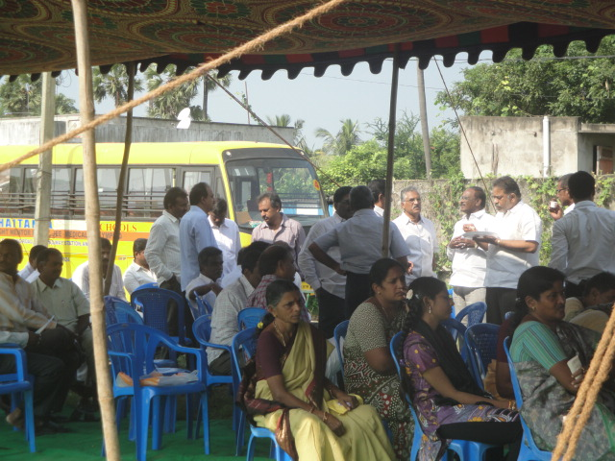
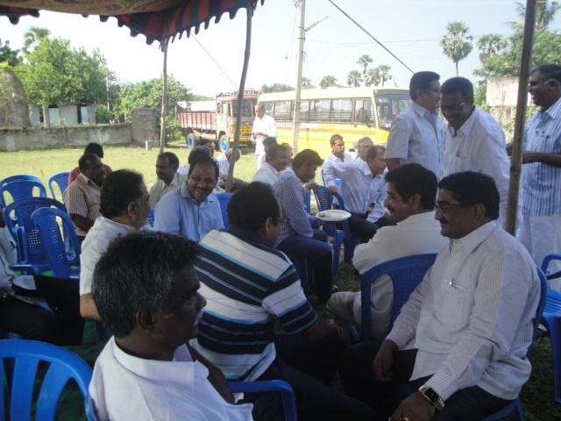
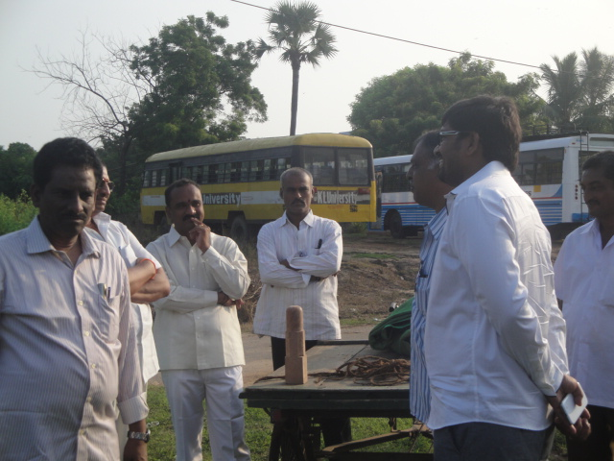
Pooja attended by well wishers

Slide 9
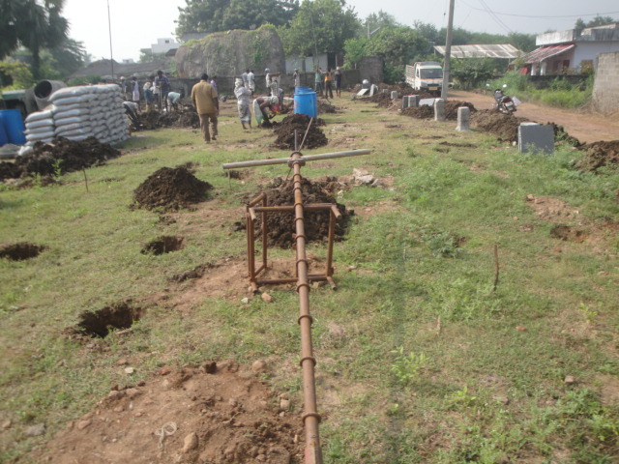
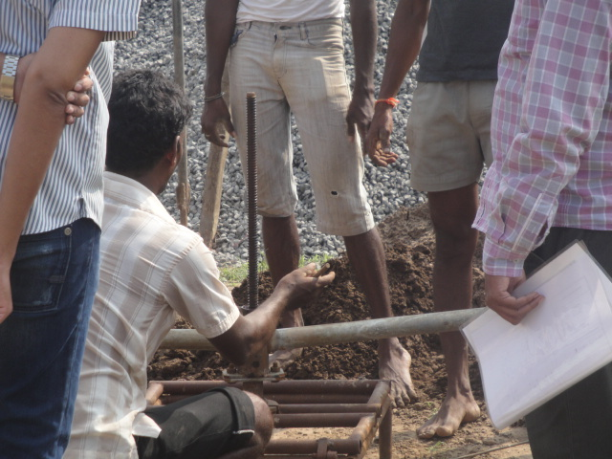
A sneer into the Quality of Work
Instrument called Under for excavating pile bulbs accurately.
Measuring depth of the pile in the presence of Engineers.

Slide 10
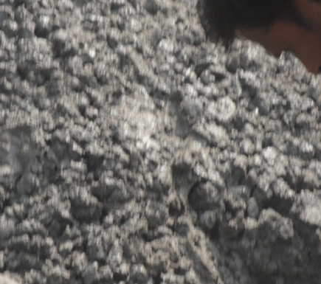
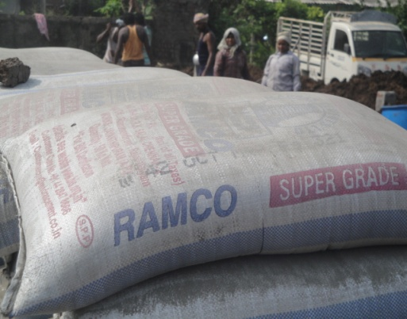
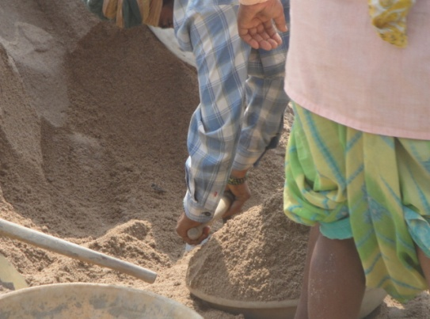
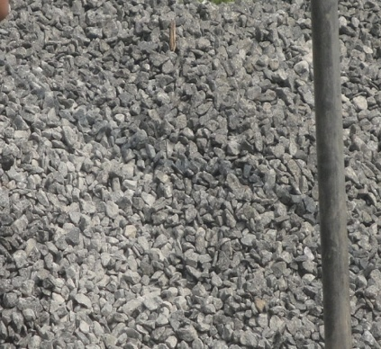
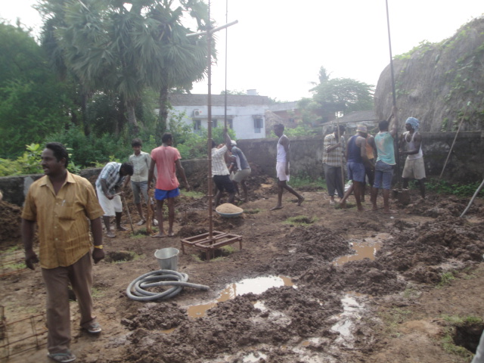
HIGH GRADE QUALITY MATERIAL
Getting rich mix of concrete with 1:1.5:3 with Ramco Super grade cement.
100% quality Sand and Metal Used in 18 feet augured piles.

Slide 11
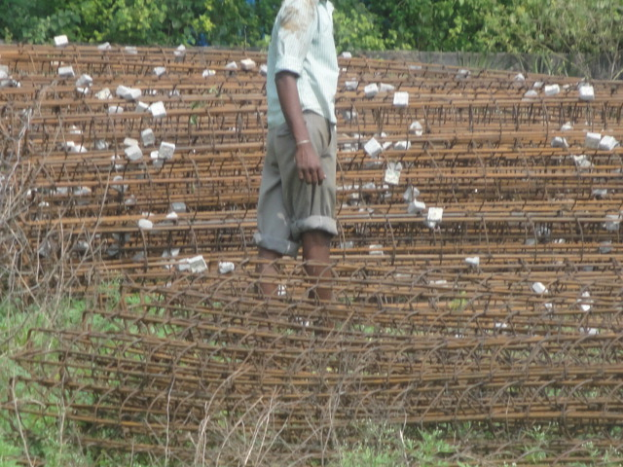
Rod-bending work in Piles.
Piles reinforcement with briquettes for cover.
127 Nos of Piles readied with relevant steel and quality tying with briquettes.

Slide 12
Understanding Pile Foundation
After the tsunami incident there has been concerns on the strength of apartments in coastal Andhra. Keeping this in mind we at Landmark , have adopted the Pile Foundation concept that would give Extra reinforcement to the building.
This is the First of its kind in Coastal Andhra , ------------------------------------------

Slide 13
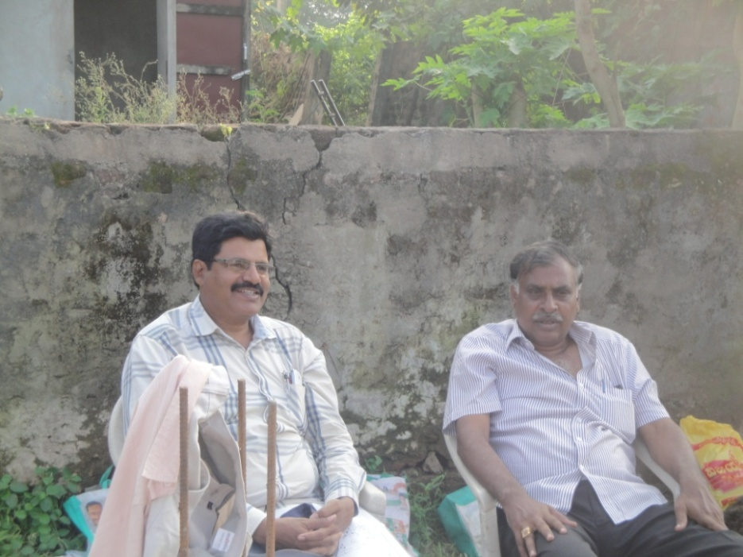
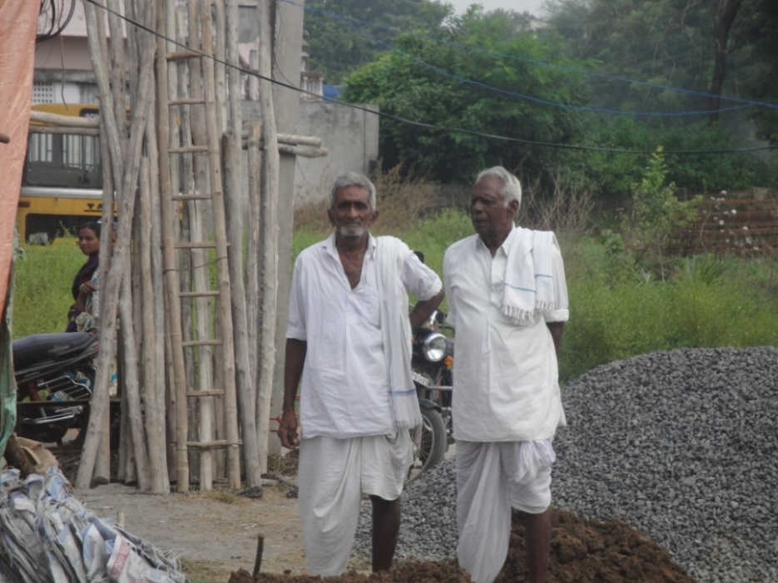
Round the clock Supervision
Engineer and Executor of Work supervising
Builder ( On the right) with traditional look and scientific bent of mind with his friend.

Slide 14
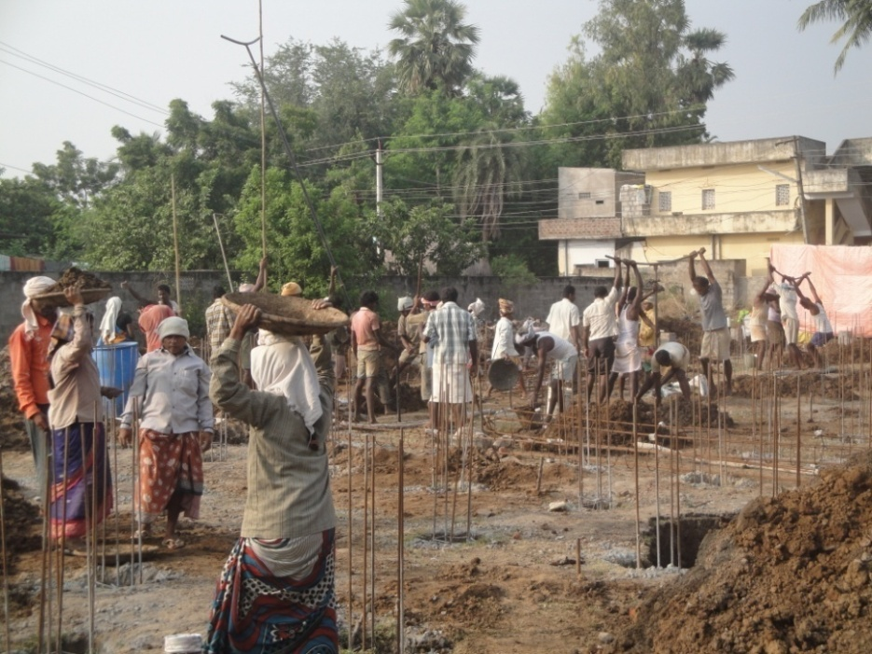
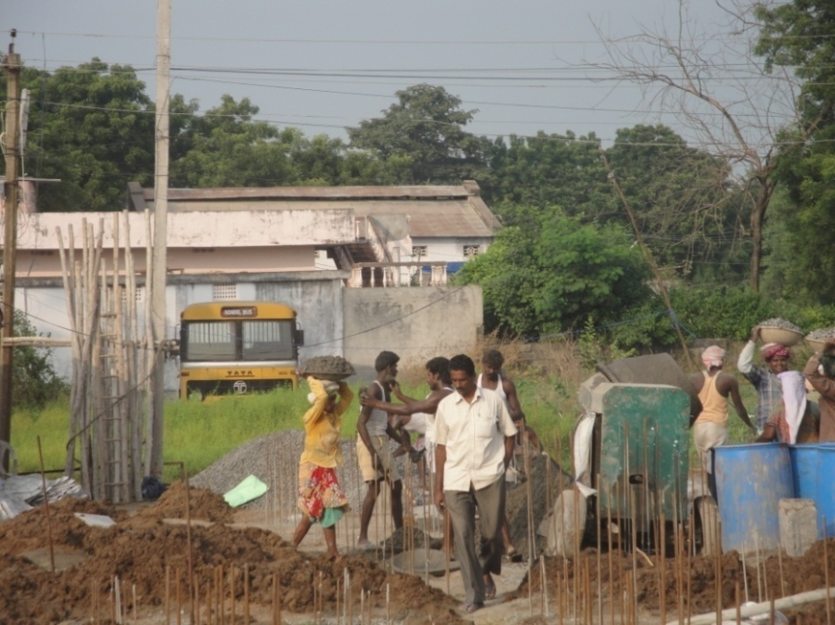
Work In Full Swing

Slide 15
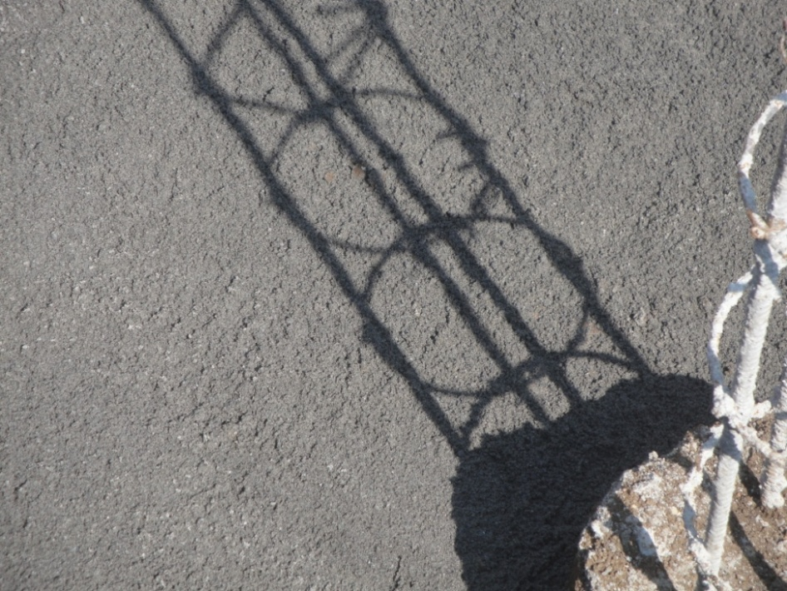
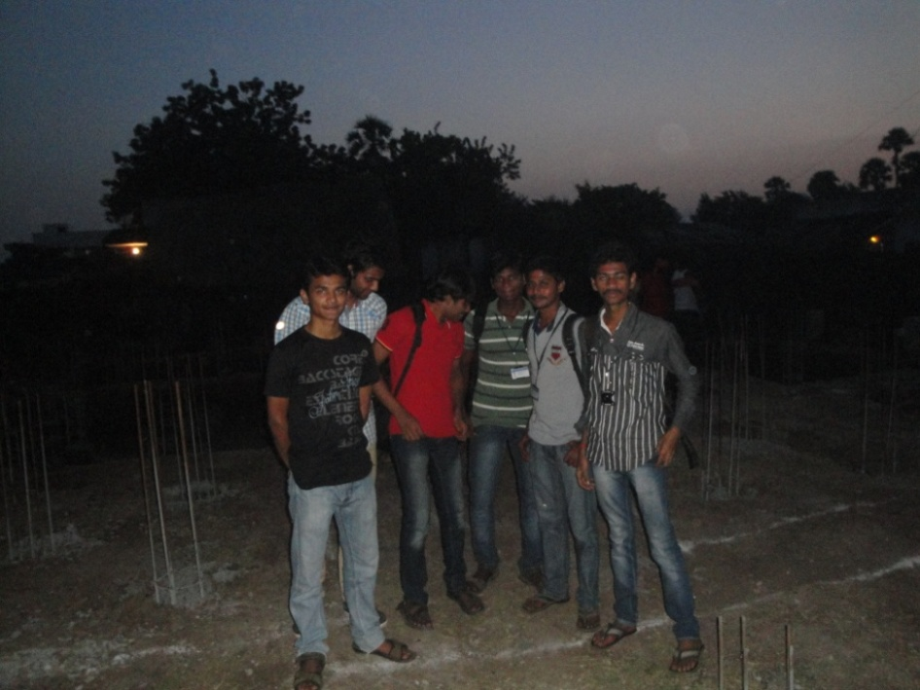
Robo sand filled for Pile cap preparation, Siddhartha Engineering college students visit the site to know about the 100% Earth quake technology implementation practically.

Slide 16
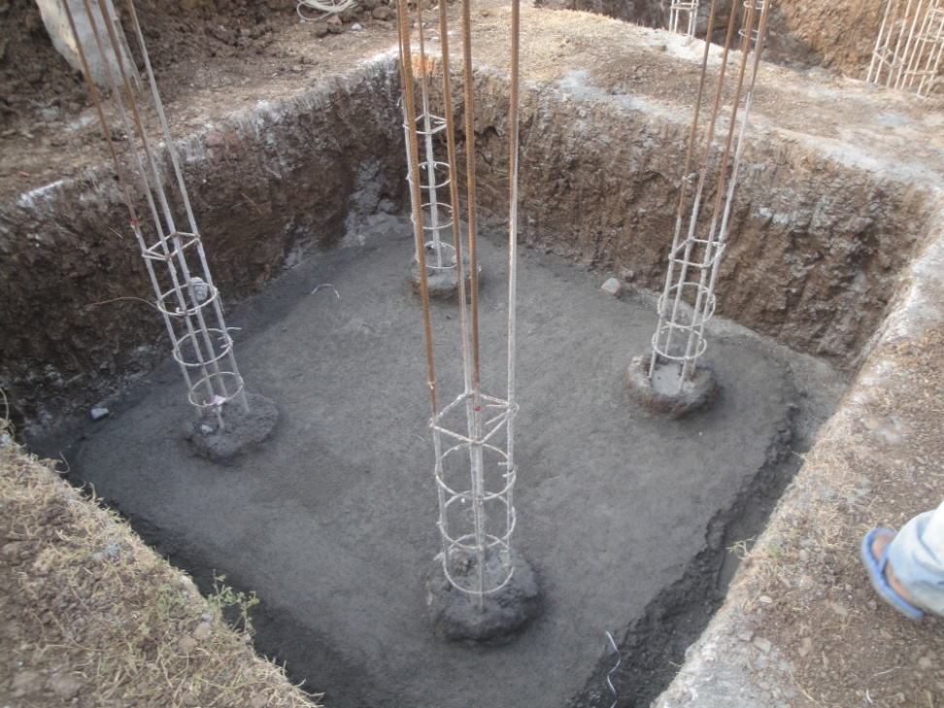
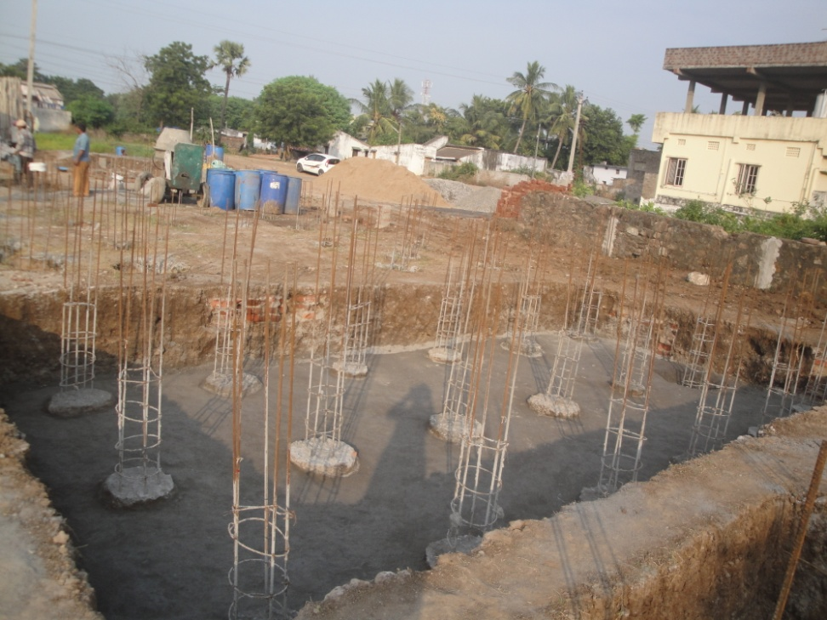
PCC of 6 inch laid for pile cap, 2 inch protruding pile top which is essential for the pile cap for the best performance.

Slide 17
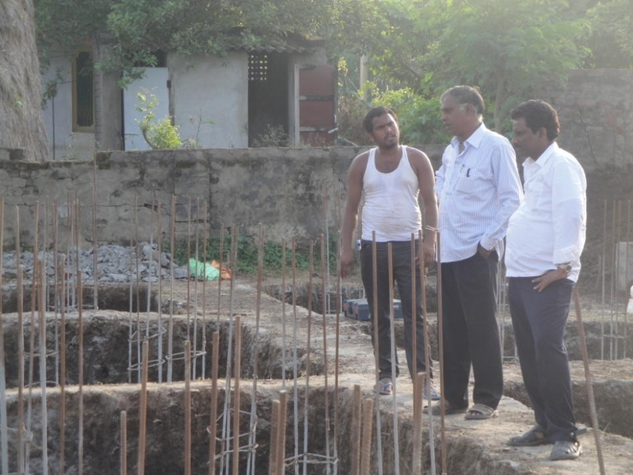
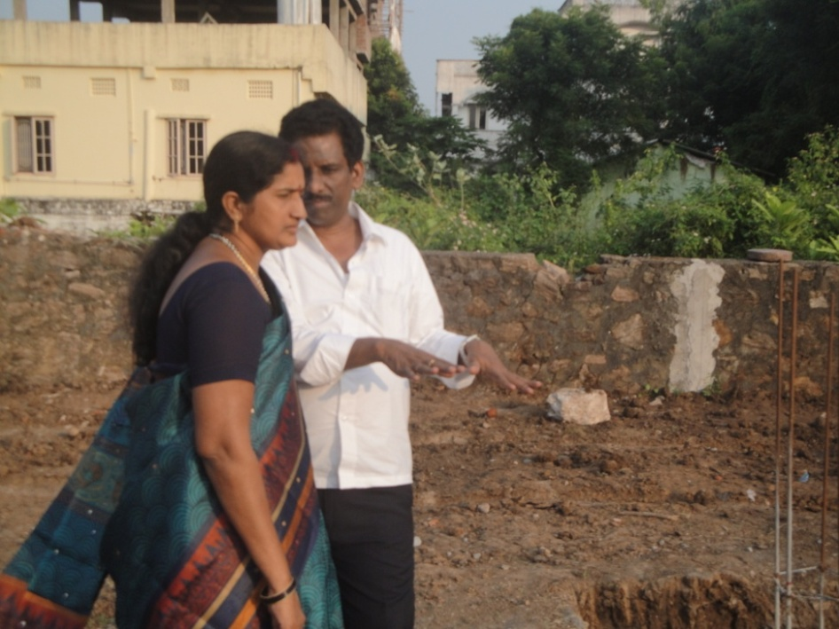
Mr. Bankim Chand Chalasani (First from the right), buyer of a two & three bed room flat, visited the site along with his family while the work was in progress.

Slide 18
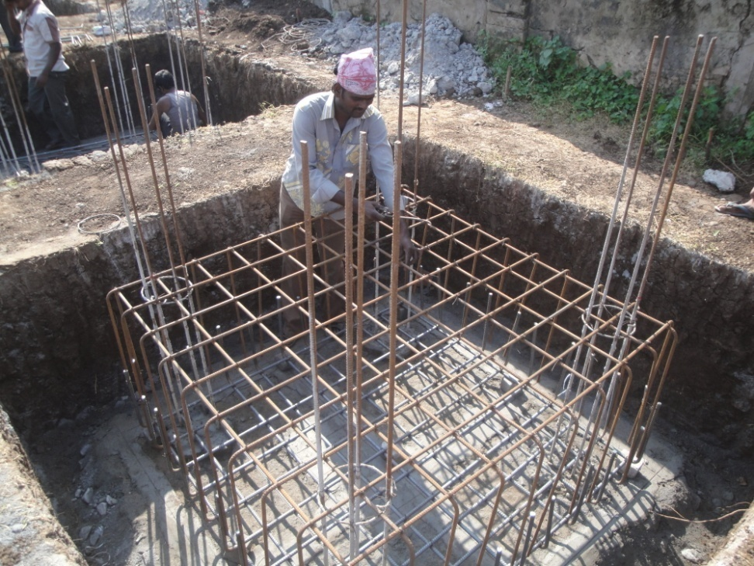
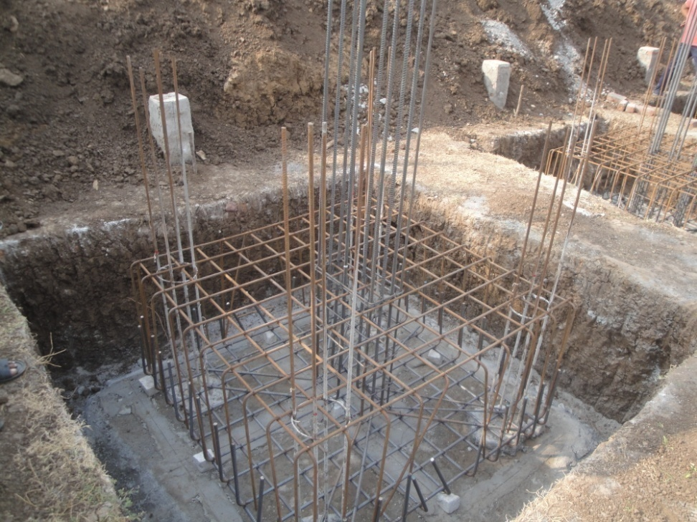
Pile cap reinforcement and columns, steel used as per design specification.

Slide 19
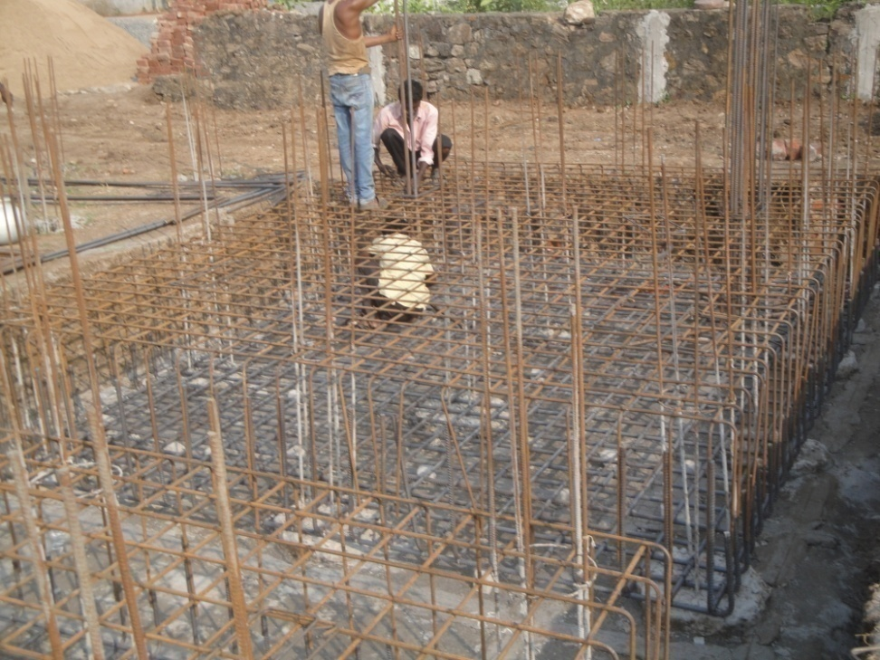
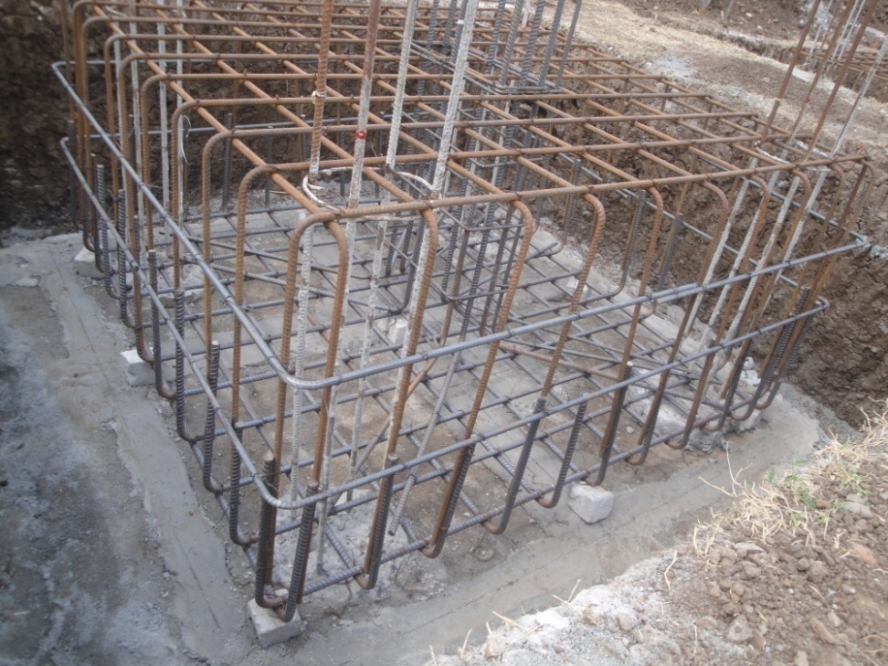
Pile cap 3.4 feet height after removing loose soil from the site, soil tested by the eminent institution V R Siddhartha Engineering College.

Slide 20
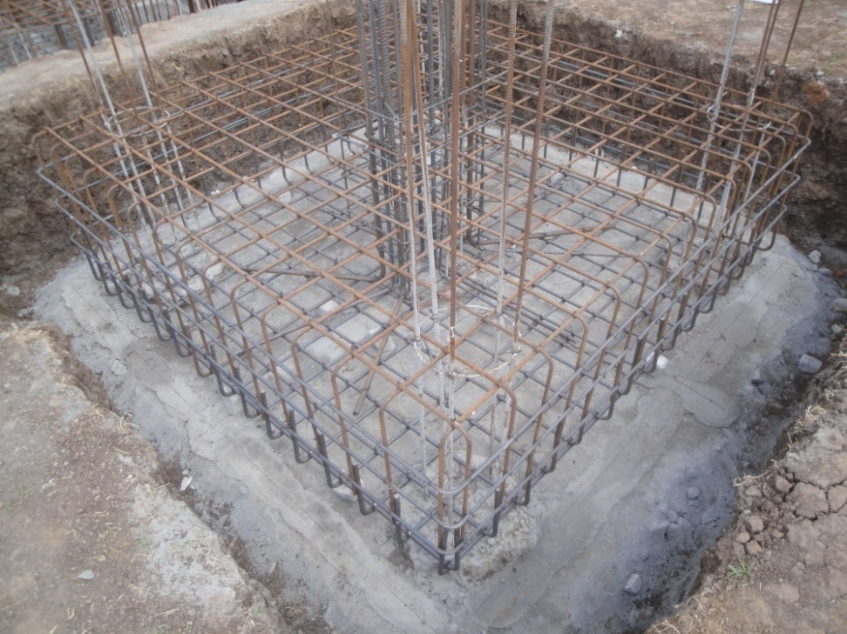
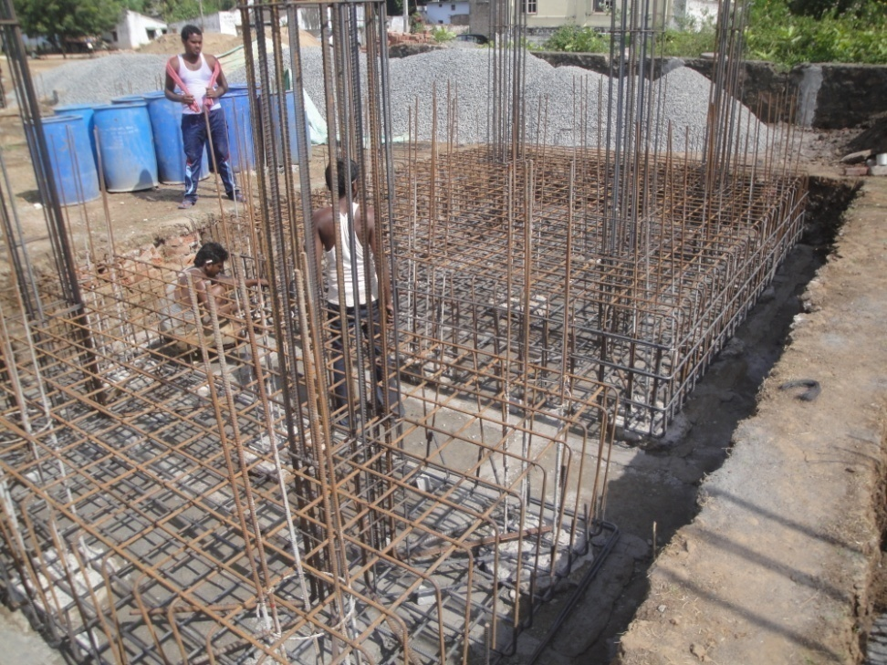
Pile cap after reinforcement with columns placement

Slide 21
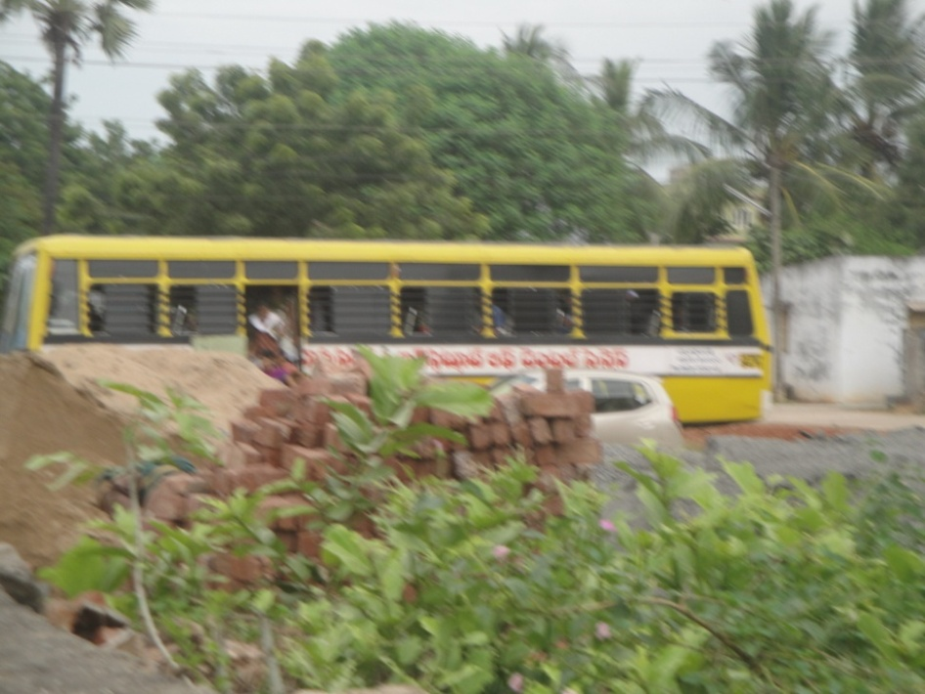
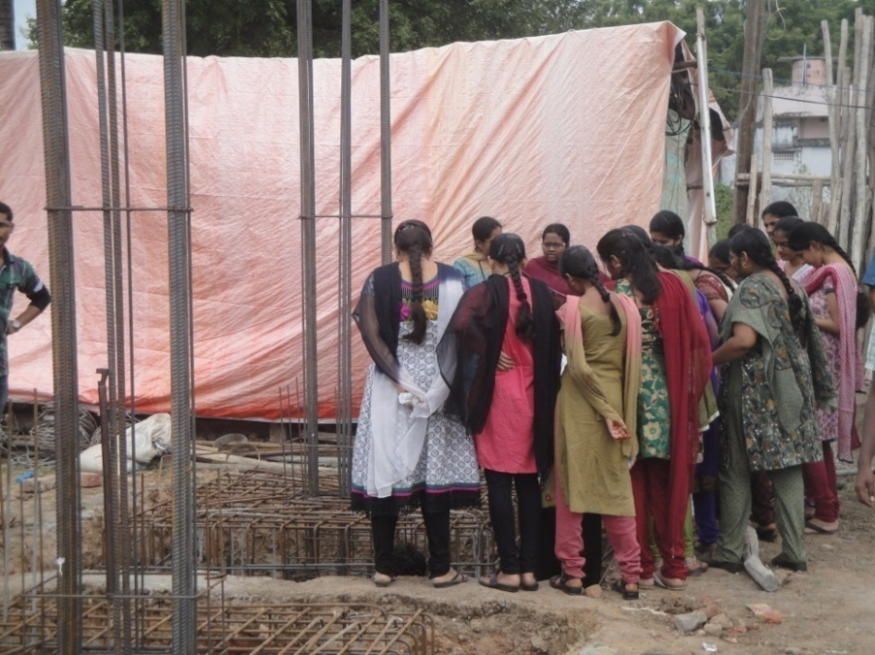
Around 60 students of V.R Siddhartha Engineering college visited the site to know and study about the latest Earth quake technology implementation.

Slide 22
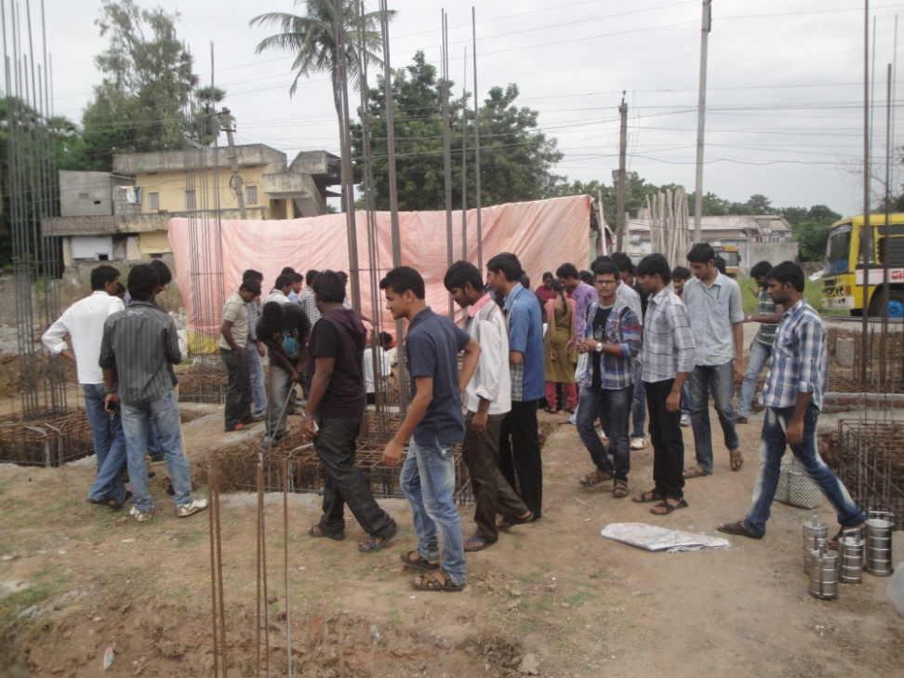
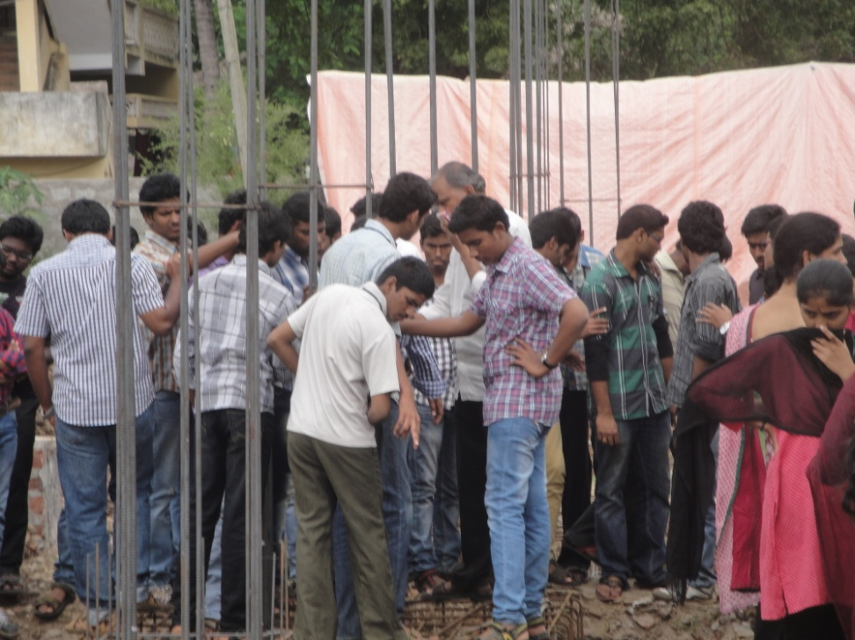
Asst. Professor Mr.V. Ramesh explaining the students, the importance of the earthquake technology in coastal areas.

Slide 23
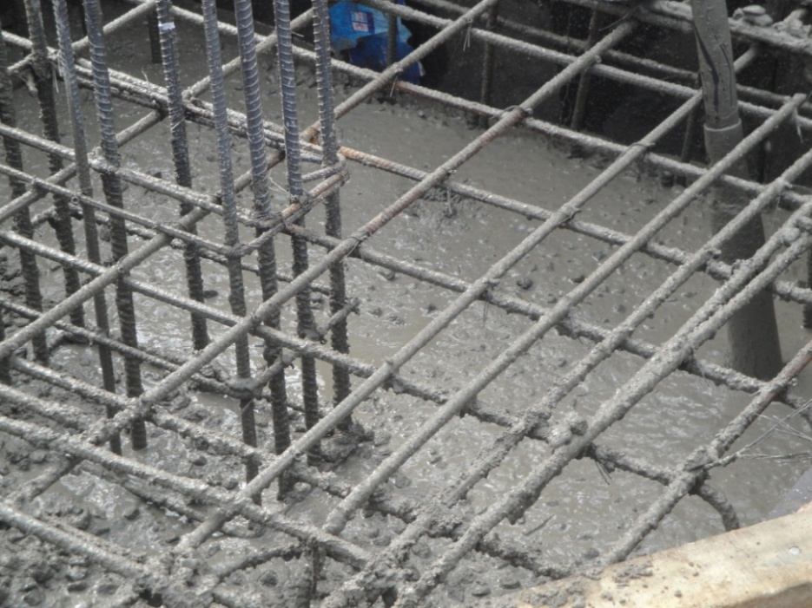
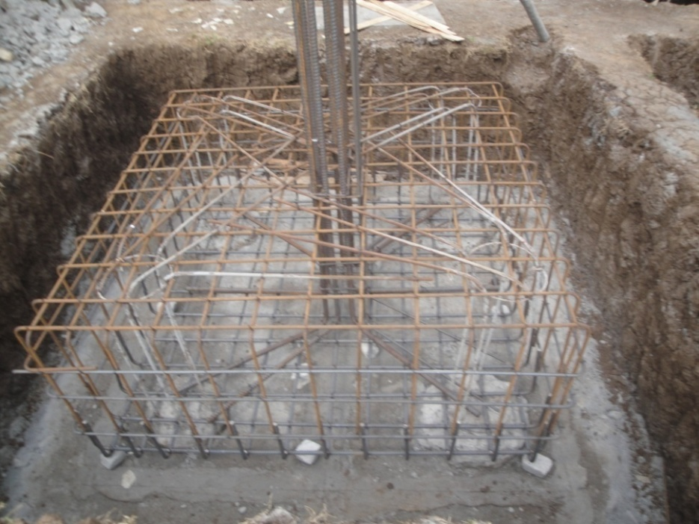
Concreting the pile cap and cover of 3 inches in bottom and all side after centering.

Slide 24
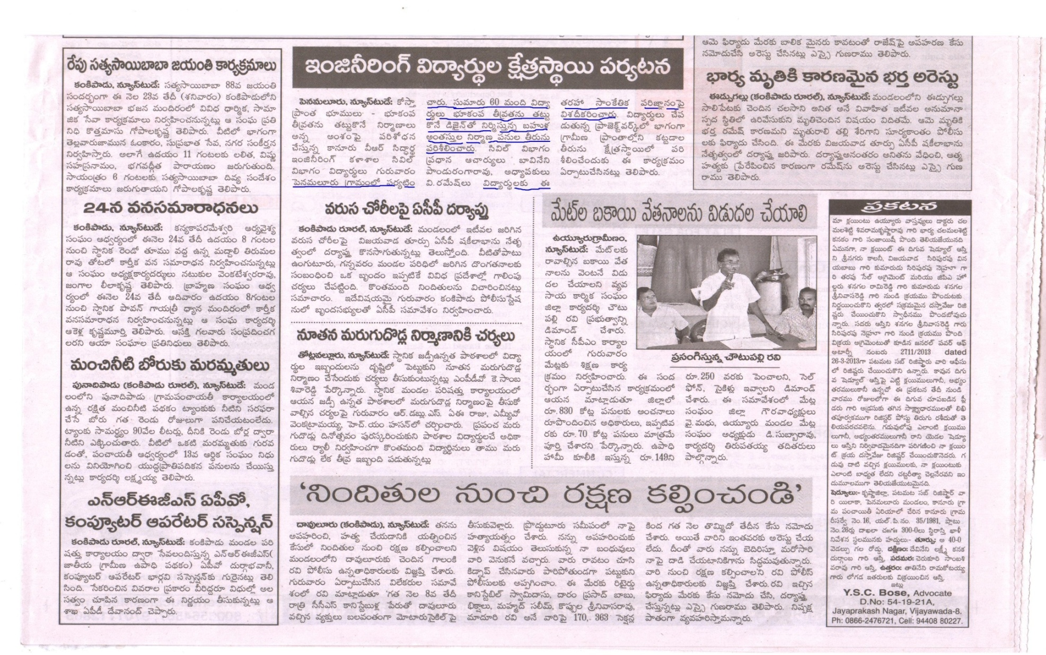
Excerpt from a news article in EENADU about the college students visit

Slide 25
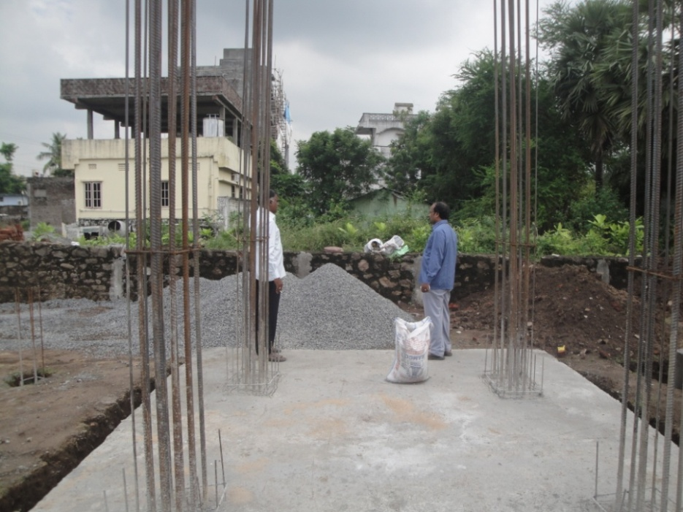
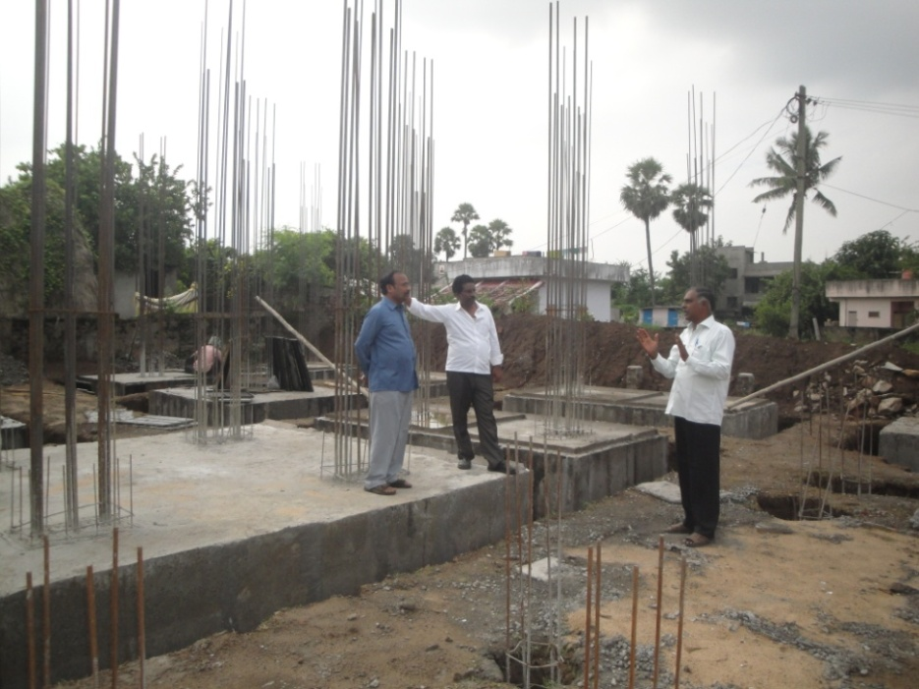
Mr.Kishore, a reputed Chartered Accountant from Chennai, prospective buyer of a 3 bedroom flat visited the site for the second time after finishing the pile cap concrete

Slide 26
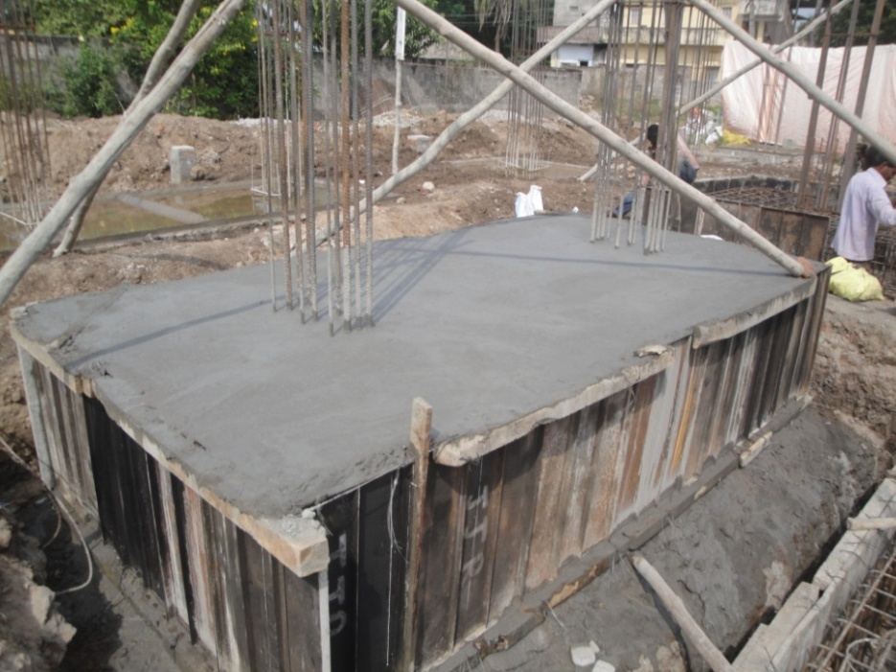
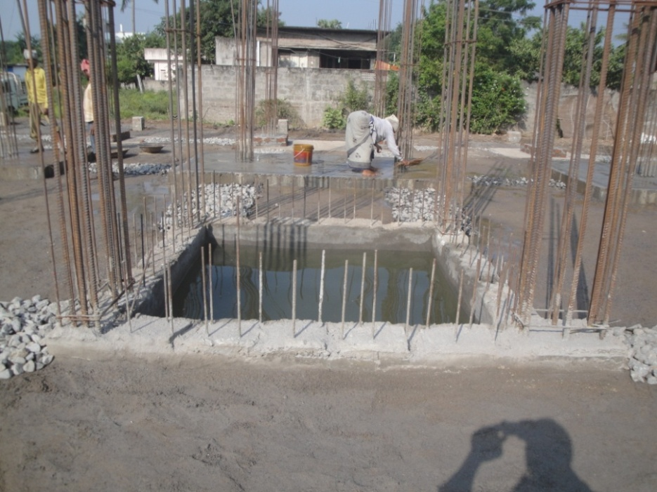
Lift room with 9 inches concrete and site filled with crusher dust.

Slide 27
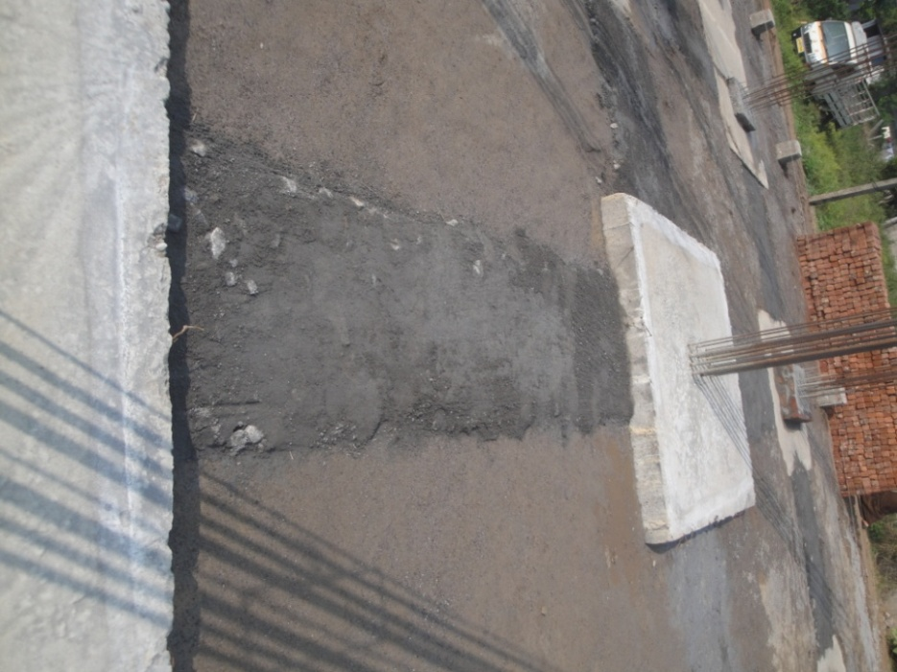
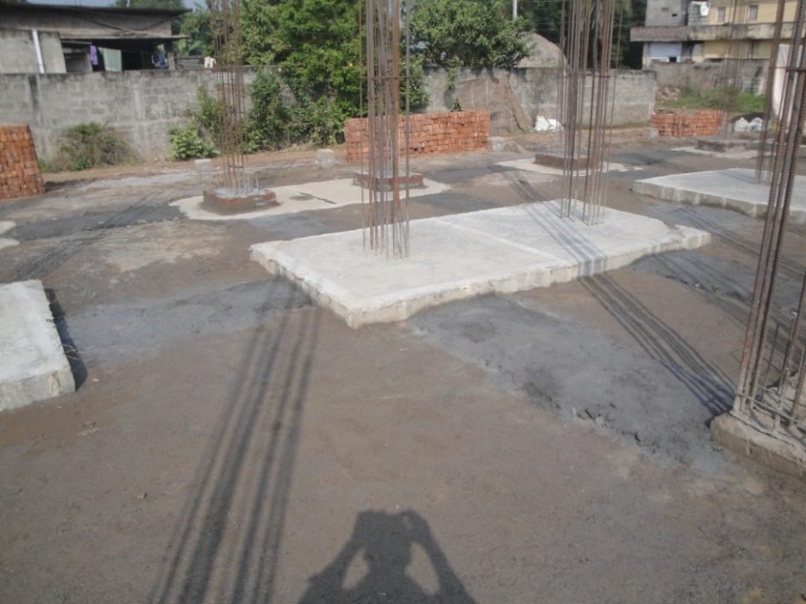
Beam on ground level that is on top of the pile cap prepared with PCC and brick work under it for best packing and top rating quality.

Slide 28
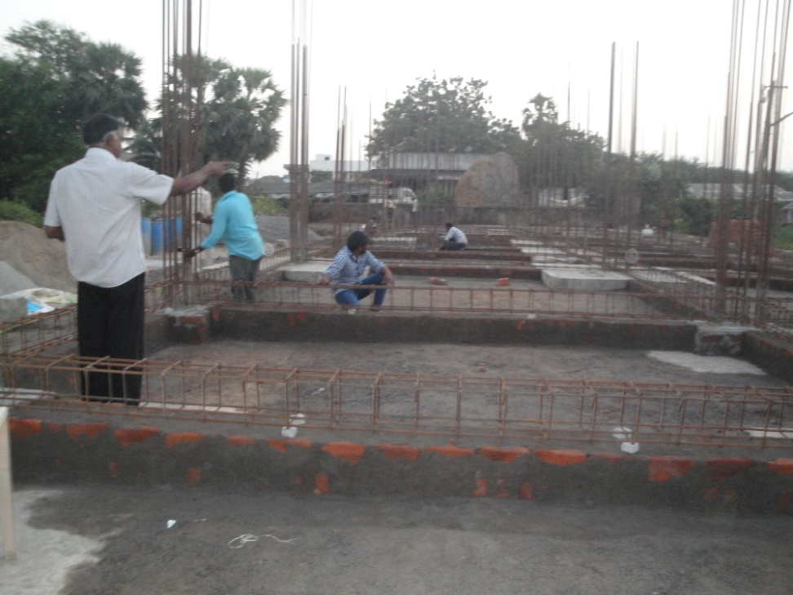
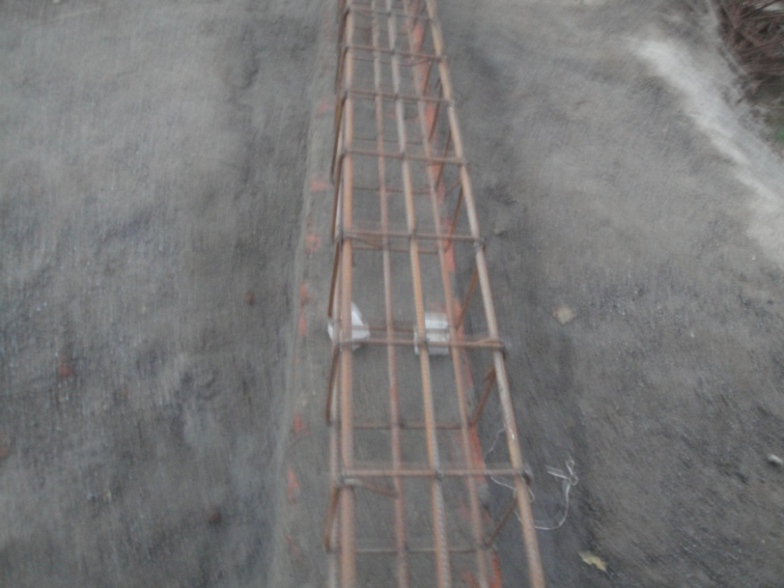
Brick work and PCC for the beam
Brick work on PCC for the ring beam on top of the pile cap
Reinforcement for the beam

Slide 29
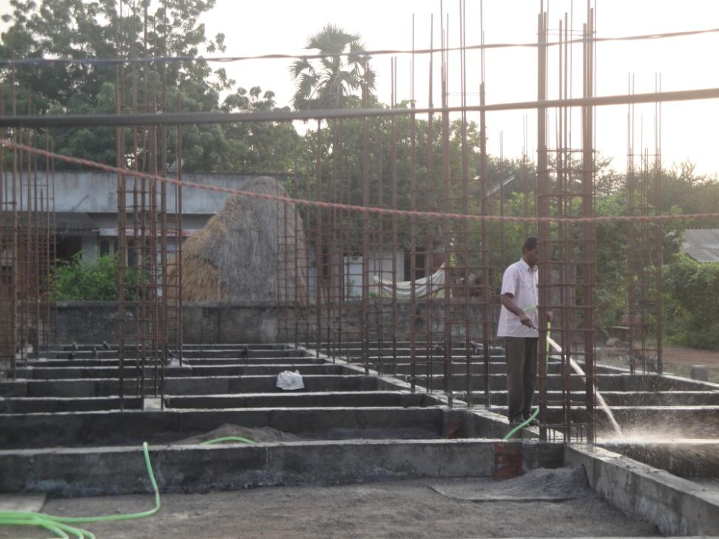
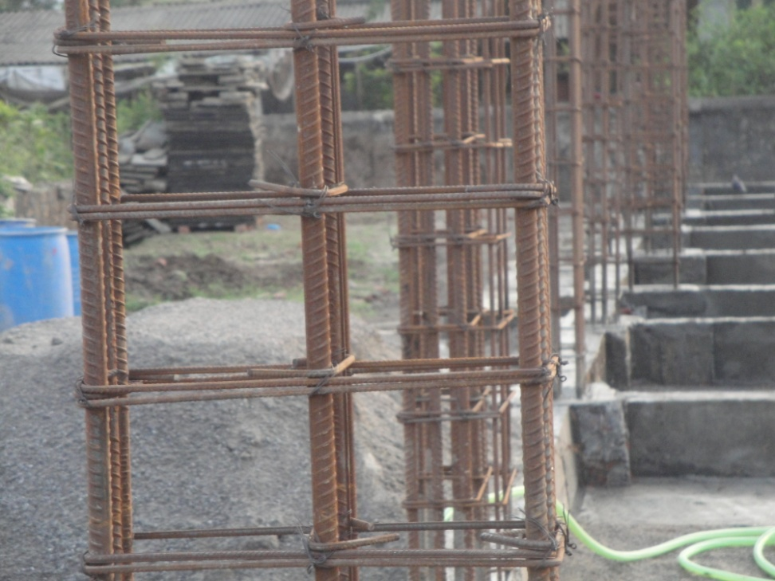
Watering the Plinth Beam and columns with stirrups and tie for added security.

Slide 30
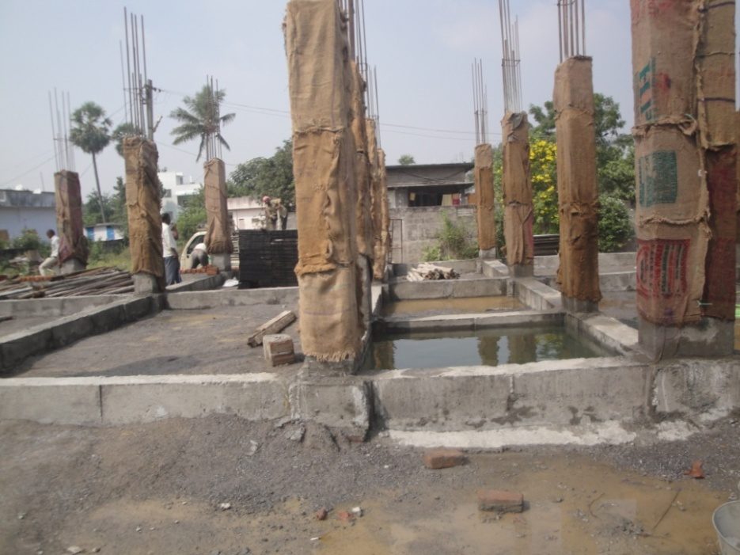
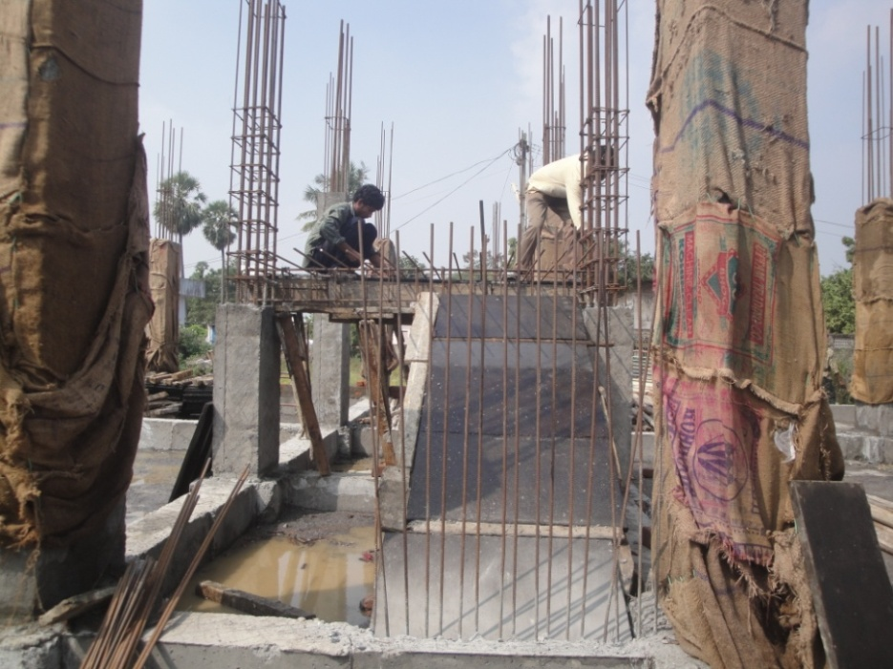
Gunny Bags for column curing and centering for the steps

Slide 31


Building is not just a home but a hope for a better future.
Location: Penamaluru, Vijayawada-521139, Contact No: 09440882288
Notes:
Address: Penamaluru, Vijayawada-521139. Contact No.09440882288

